Slide 1

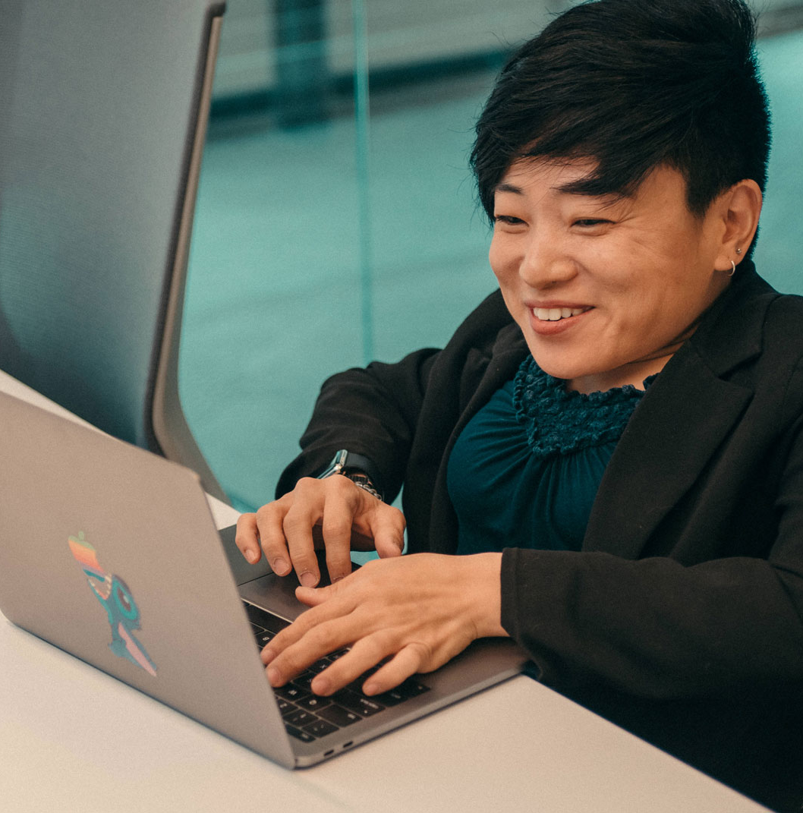

Creating Effective Emails
Tips & Best Practices
Spring 2023

Slide 2

Crafting the Perfect Email

Slide 3
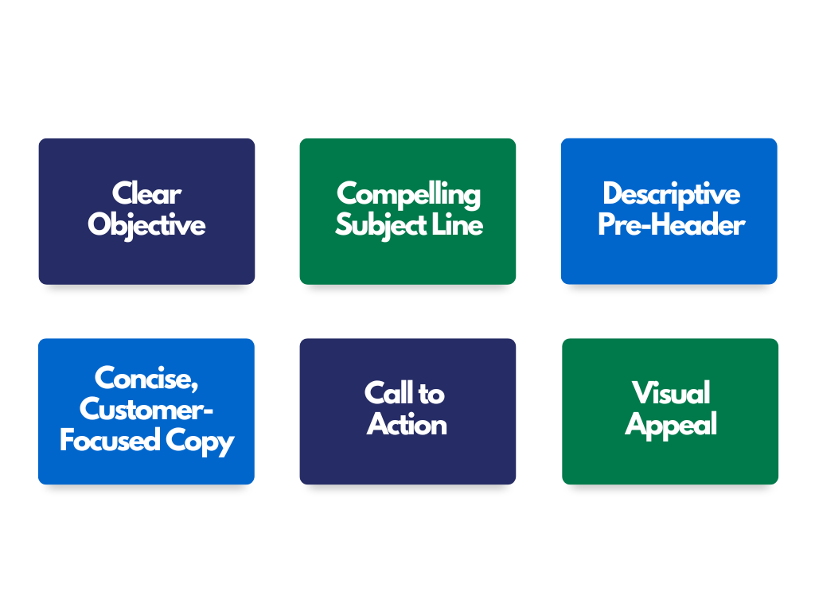
Elements of Effective Emails
Great emails include the following:
Notes:
A clear objective: WHY are you sending this email?
A compelling subject line: In 9 words or less, why does your audience want to open this email?
GAAD Open rate was at 36%, Industry average is 21%
A descriptive pre-header: In 10 words or less, what does this email say?
Clear, concise, customer-focused copy:
General rule is that emails should cover ONE topic.
Emails should be VERY short and avoid too much text. If a reader needs to scroll on your email, the chances of them being read is very low.
Example: On our past three Lineups, readership drops after the "Current Partnership Opportunities" section (about 1/3 into the email and "above the fold")
Maybe include 1-2 additional topics, only if they are expressly related.
A singular, prominent call to action: What action do you want recipients to take?
Visual Appeal: In-line with brand standards, sleek.

Slide 4
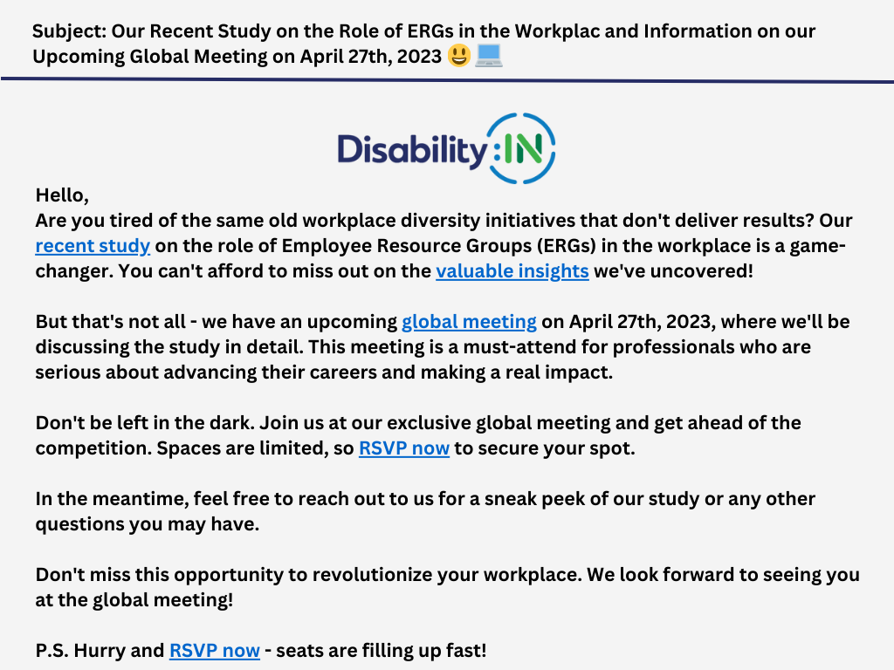
Example:
What changes would you make?
Notes:
Spelling errors in the subject line
LONG and confusing subject line
Too much text.
Unclear CTAs and links in multiple areas.
No graphics or visual interest.

Slide 5
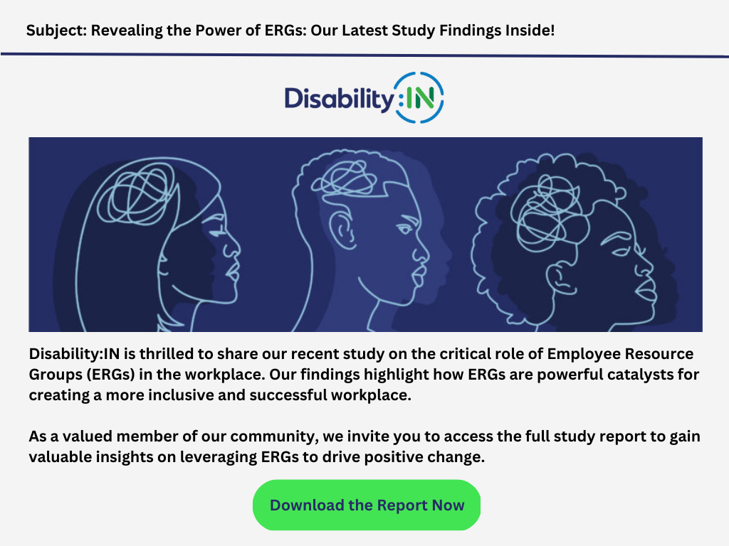
Example #2:
Clear Objective
Compelling Subject Line
Concise Copy
Clear Call to Action
Visual Appeal

Slide 6
Tips for Better Email Strategy

Slide 7
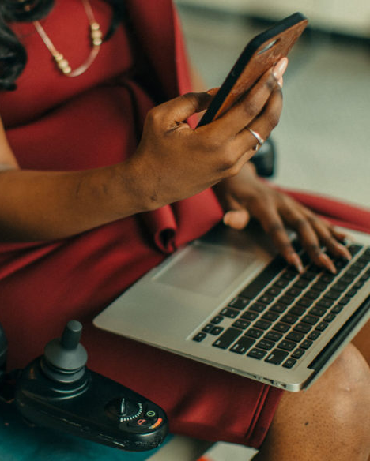
Tips to Keep in Mind:
Wednesdays & Fridays are the best days to send emails.
Mornings (8-11:30 AM) are the best times to send emails.
Avoid words like "reminder," "member," and "meeting" in your subject line.
Create a "campaign" calendar.
Use Viva Insights (Outlook) to track opens on your emails.

Slide 8
Email Accessibility

Slide 9
Tips to Keep in Mind:
Avoid including tables or very long lists.
Left-align all text.
Include alt-text on all visuals.
Include accessible hyperlinks.
Use accessible text colors and fonts (like "Arial").
Learn more via Microsoft.

Slide 10
Questions?

Slide 11

Thank You!
Allie Torres
Manager, Marketing & Communications
Allyce@DisabilityIN.org

